Slide 1
Analyzing and Predicting Purchase Behaviour in the
E-commerce Industry
A DATA-DRIVEN STUDY USING SEPHORA SKINCARE REVIEWS

Slide 2
INTRODUCTION
Objective
Understand customer behavior in the e-commerce skincare industry.
Dataset
Sephora Products and Skincare Reviews from Kaggle.
Approach
Descriptive, Predctive, and Prescriptive Analysis

Slide 3
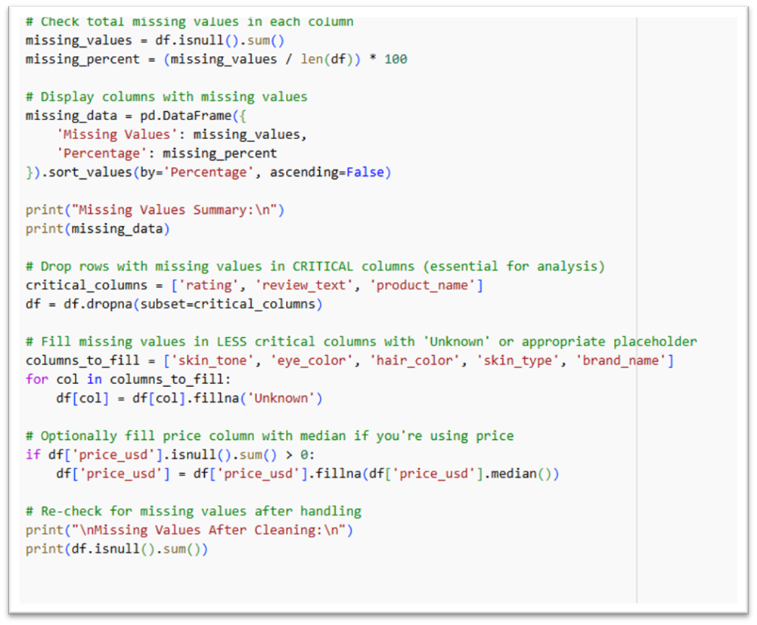
DATA GATHERING AND PREPROCESSING
Source
Kaggle (Sephora Reviews, 5,000+ Reviews)
Key Attributes
Review Text, Rating, Product Name, Skin Type, Price
Preprocessing
Removed Duplicates
Handled missing values
Added review_length feature

Slide 4
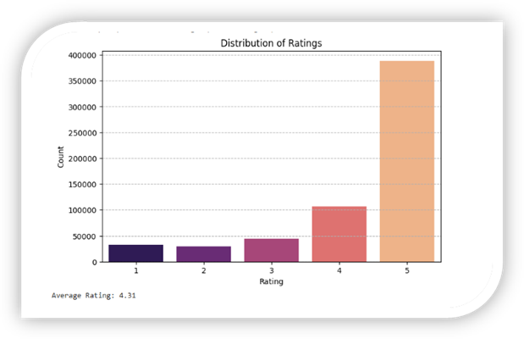
DESCRIPTIVE ANALYSIS - RATING & PRODUCTS
Average Rating
4.31 (Mostly 5 Stars)

Slide 5
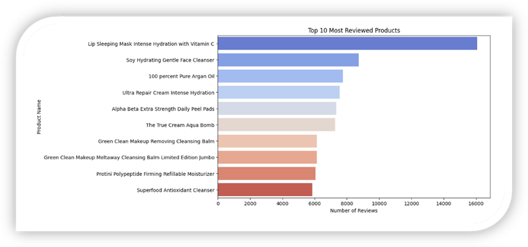
DESCRIPTIVE ANALYSIS - RATINGS & PRODUCTS
Top Reviewed Prodcut
Lip Sleeping Mask Intense Hydration

Slide 6
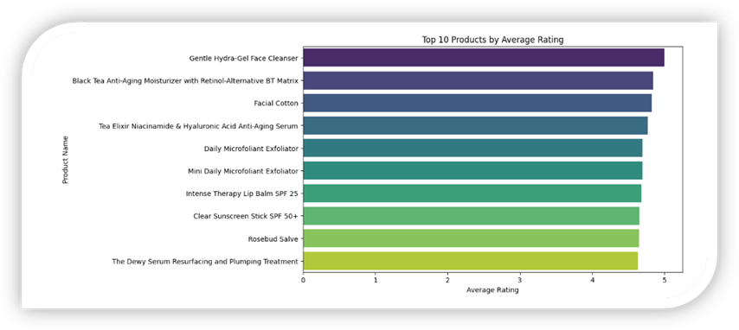
DESCRIPTIVE ANALYSIS - RATINGS & PRODUCTS
Top Rated Product
Gentle Hydra-Gel Face Cleanser

Slide 7
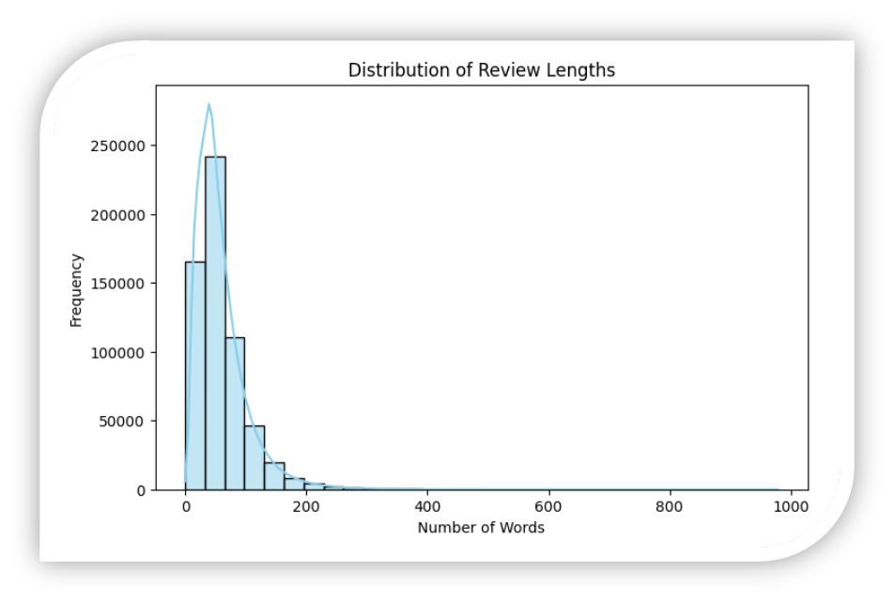
DESCRIPTIVE ANALYSIS - CUSTOMER INSIGHTS
Review Length
Average 59.17 words - right skewed

Slide 8
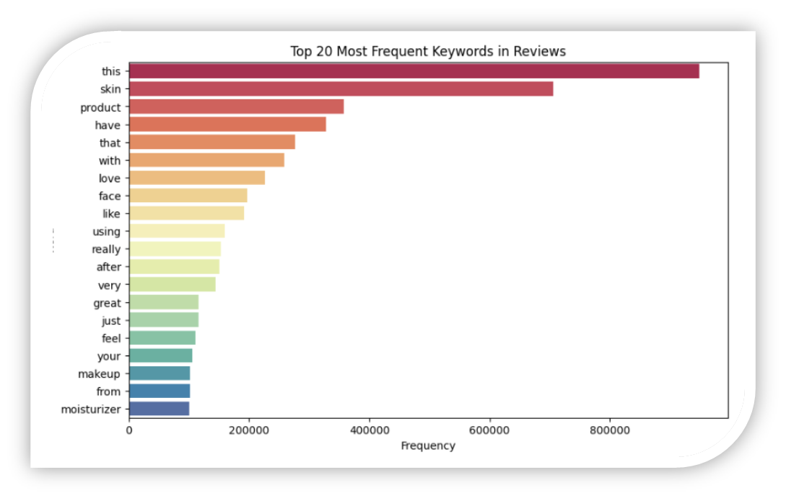
DESCRIPTIVE ANALYSIS - CUSTOMER INSIGHTS
Keywords
Frequent use of words ‘skin’, ‘product’, ‘love’

Slide 9
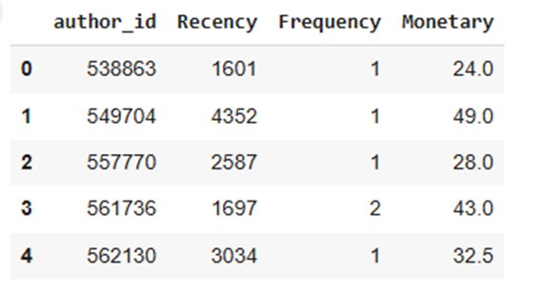
PREDICTIVE ANALYSIS
RFM Analysis
Days since Last Review, Number of Reviews per customer, and average product price reviewed.

Slide 10
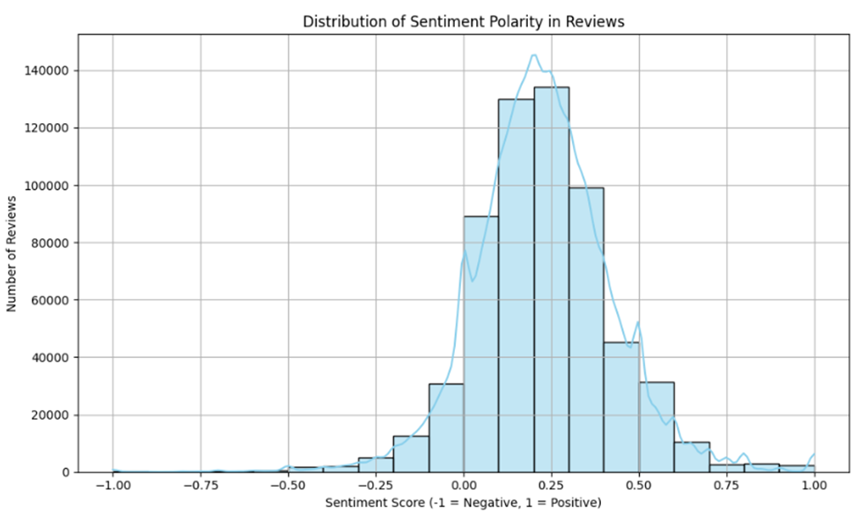
PREDICTIVE ANALYSIS
RFM Analysis
Days since Last Review, Number of Reviews per customer, and average product price reviewed.
Sentiment Analysis
Most reviews are positive, peaking at 0.5.

Slide 11
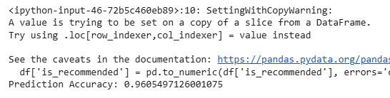

PREDICTIVE ANALYSIS
Random Forest Classifier
Random Forest Classifier, 96.06% accuracy.
Sentiment Analysis
Most reviews are positive, peaking at 0.5.

Slide 12
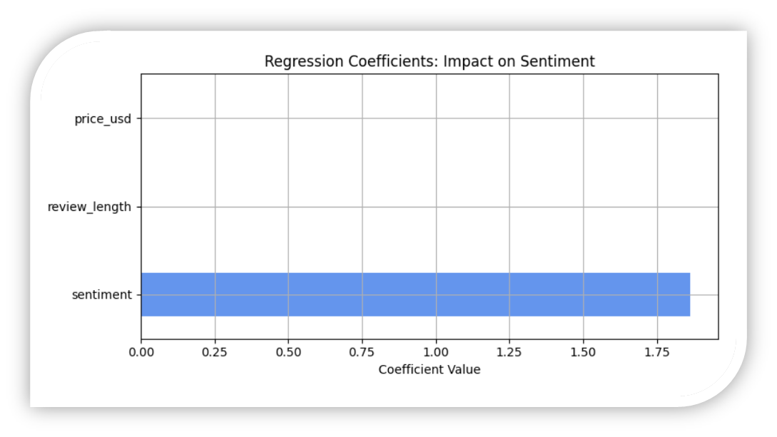
MULTIPLE REGRESSION ANALYSIS
Model
Predicted Rating using Sentiment, Review Length, Price
Results
R-Squared = 0.098
Sentiment has the largest impact

Slide 13
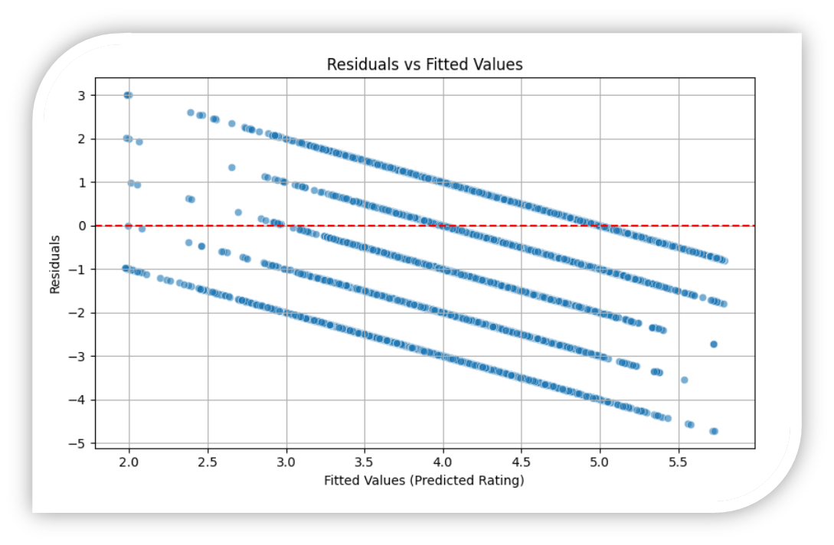
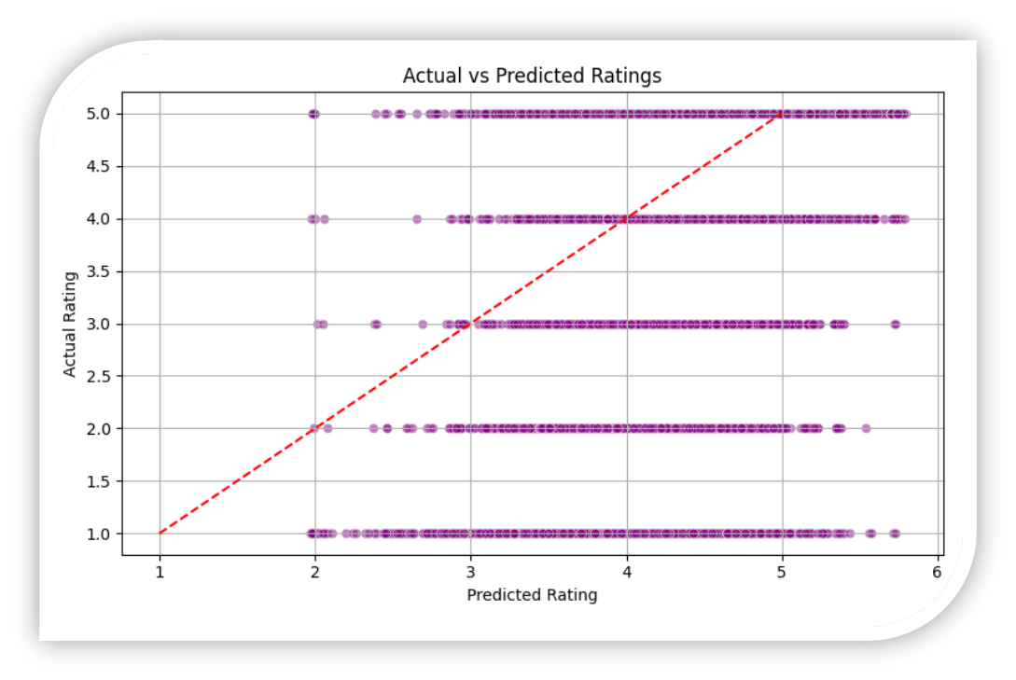
MODEL VALIDATION
The model shows good predictive accuracy and fits well across ratings, with no major assumption violations.

Slide 14
KEY INSIGHTS AND RECOMMENDATIONS
Insights
High satisfaction overall, but some products have negative sentiment.
Sentiment drives ratings the most.
Dataset
Improve products with negative feedback.
Target high-value customers with personalized offers.
Encourage detailed reviews to boost ratings.

Slide 15
CONCLUSION
Successfully analyzed customer behavior using Sephora data.
Predictive model accurately forecasts recommendations.
Actionable insights can enhance customer satisfaction and business performance.

